Slide 1
Color Temperature based Indoor Lighting
Principle:
The colour of light affects the circadian rhythm (internal process that regulates the sleep-wake cycle).
Modern day LED and other artificial light sources tend to have a constant intensity and frequency, and thus alter our sleeping cycle along with reducing our efficiency while we’re awake.
The proposed lighting device will regulate its own colour based on the time of day and provide the optimal frequency and intensity of light throughout the day to maximise productivity and reduce stress. It can also help people with sleep disorders, elderly people and those with SAD ( Seasonal Affective Disorder). It will also have manual options for the user to choose a mode of lighting, in order to increase activeness or promote relaxation.
General working of the device will be via an arduino uno connected with a wireless module, which will import the daylight cycle data daily, configure the lighting cycle accordingly, and then provide the RGB LEDs with the required configurations, while accordingly editing their settings throughout the day. The user will also have the option of chose a specific submode, which will override the settings and provide a specific type of pre-set light.

Slide 2
Research and References:
https://pubmed.ncbi.nlm.nih.gov/8979406/ https://www.ncbi.nlm.nih.gov/pmc/articles/PMC4985169/
https://www.cdc.gov/niosh/emres/longhourstraining/color.html
https://pubmed.ncbi.nlm.nih.gov/9682518/
https://pubmed.ncbi.nlm.nih.gov/26098084/
https://pubmed.ncbi.nlm.nih.gov/8327605/
Final Output:
Light emitted that is ideal for humans based on the period of day ( or by user requirement, if manually edited).
Applications:
Helps increase productivity and set a good wake-sleep cycle. Can help people with sleep disorders, elderly people and those with SAD ( Seasonal Affective Disorder).

Slide 3
Execution:
Make container for the RGB LEDs and external support required.
Create circuit for Arduino UNO along with LEDs, switches and wifi module.
LEDs will be connected parallel to 4 PWM digital ports of the arduino, three will send the light frequency data and the other will regulate intensity via voltage regulation.
Programming of interface of arduino with LED along with the process for it to import required data from web.
Create user interface for manual control ( Not required/ advised, device is meant to work based on pre-existing scientific data).
Resources:
Multiple RGB LEDs
Container for LEDs ( such as an empty LED tube) + External Support structure
Arduino UNO
Wireless Module (ESP8266)
Breadboard/PCB
Multiple Switches for User input.

Slide 4
Tasks allotment:
Building the structure and supports of the device.
Creating the circuit of the arduino.
Programming the the arduino to take user inputs and data from the web, processing it, and providing corresponding output.
Research, a large amount of research will have to be done to compile various frequency and intensity data from multiple research papers and sources along with finding an ideal mapping between light ( frequency, intensity) vs time of day.
Most tasks will require multiple people.
Challenges:
While the topics itself is well researched, it is difficult to get access to full studies, along the accompanying data. Even with the data, most of it will have to be interpreted in a way that can be applied to the device.

Slide 5
Week’s progress (21 to 28 Jan): We compiled the data about preferred colour temperature during for different times of the day and pre-sets, we used various research papers for this data. We also converted the temperature data into RGB data that can be used for programming purpose, we used Wein’s law and an algorithm by Dan Bruton to convert the data. We worked on the 3D model for housing all the components and the manual controls with an OLED display to show current working conditions of the light. We also worked on the program and electrical connections for manual input form user in case Wifi is not available for current timing conditions. We also have completed the programming to make transitions between different lighting conditions during the day.

Slide 6
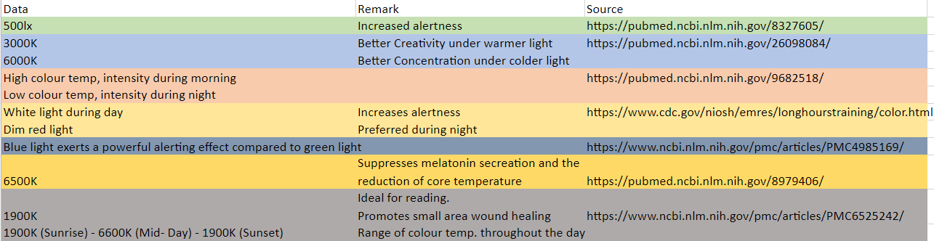
Data for preferred colour temperature
Link to the excel sheet of the data
https://onedrive.live.com/view.aspx?resid=D995DF6E4131CD2E!5667&ithint=file%2cxlsx&authkey=!AP-7I17OBRHfY8o
To convert the data from temperature(Kelvin) into the RGB form we used the Wein’s Law and an algorithm made by Dan Bruton that converts wavelength into RGB colours.
Link to the original source http://www.physics.sfasu.edu/astro/color/spectra.html

Slide 7
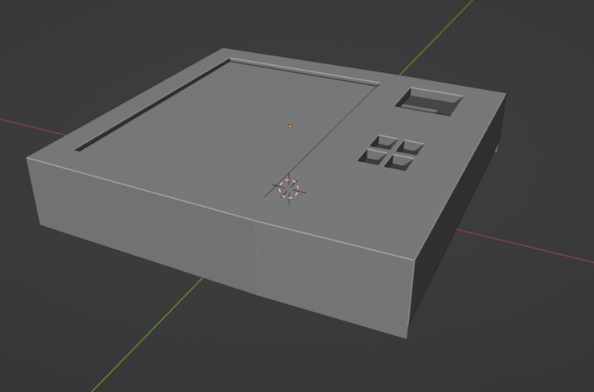
3D model of the manual control box

Slide 8
Problems we had during last week’s work :
We initially decided to use the Arduino uno with ESP8266 we wrote a program for Arduino but we could not find the required documents to program the ESP8266 or any emulator to test our code without buying the ESP8266.
After the discussion with an expert in IOT we decided to use the Node MCU microcontroller instead of Arduino + ESP8266 for project this will make the wireless communication easier and we can program the Node MCU in Arduino IDE itself.
And during the time of meet itself we found that the code we wrote for Arduino uno works with Node MCU
And now we need to work on the wireless communication part only.
Next week’s work :
We will be working on the Node MCU wireless communication and API part of it.
Design for the body, we are trying to make design that would make the spreading of light most effective.
We will be finalizing the circuit combining the different components, that each member has been working on.

Slide 9
Flowchart for the Logic handling code.
NodeMCU is turned on.
Connects to WiFi Network with pre-set credentials
GET request sent to API by client (device).
Required data is parsed and given to variables.
Current local time is used to set internal clock
API uses IP address to determine location.
Returns data for sunrise, sunset, and current local time + misc.
Slope of wavelength vs time graph is calculated.
Output PWM digital pins set to corresponding voltages
Wavelength used to calculate RGB data.
Checks current time from internal clock and calculates wavelength
Delay of 5 min

